Slide 1
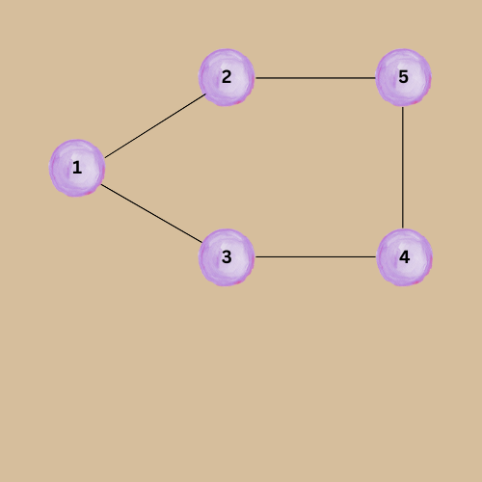
Non-Linear
Data Structure
GRAPH
Presentation by:
Anurag Singh

Slide 2
Graph
A graph G consist of two things
A set V of elements called nodes (or points or vertices)
A set E of edges such that each edge e in E is identified with a unique (unordered) pair [u,v] of nodes in V, denoted by e = [u,v]

Slide 3
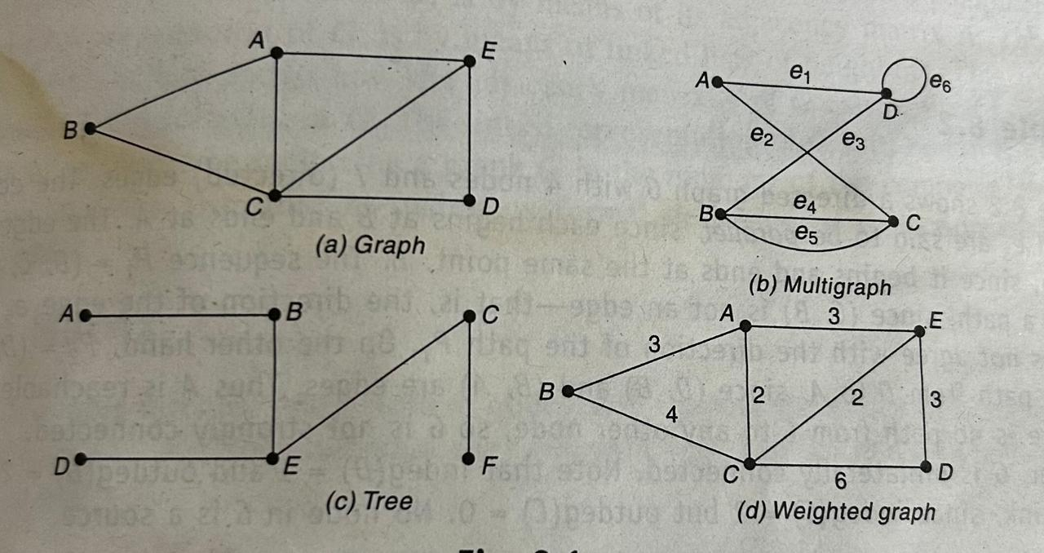
Graph Terminology
Adjacent Node
Degree of Node
Isolated Node
Path
Cycle
Complete Graph
Tree graph
Weighted Graph
Multiple Edges
Loop

Slide 4
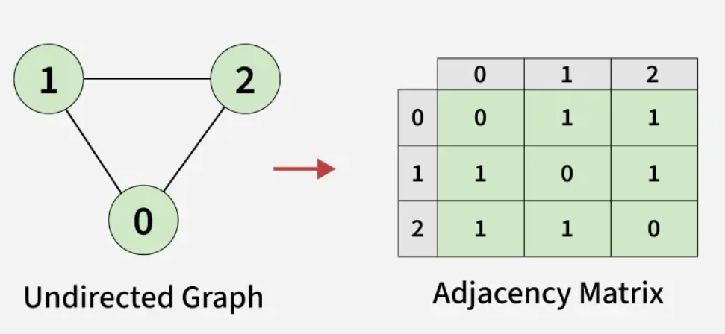
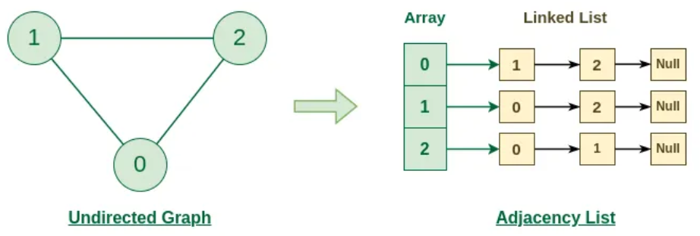
Representation of Graph
Representation of Graph are of two types:
1. Sequential Representation
2. Linked Representation
Sequential Representation
Linked Representation

Slide 5
Path Matrix
Adjacency Matrix: A¹
Nodes | X | Y | Z | W
X | 0 | 1 | 1 | 1
Y | 0 | 0 | 0 | 1
Z | 0 | 1 | 0 | 1
W | 0 | 0 | 1 | 0
X
Y
Z
W
Illustration Graph

Slide 6
Path Matrix
Adjacency Matrix: A²
Nodes | X | Y | Z | W
X | 0 | 1 | 1 | 2
Y | 0 | 0 | 1 | 0
Z | 0 | 0 | 1 | 1
W | 0 | 1 | 0 | 1
X
Y
Z
W
Illustration Graph

Slide 7
Path Matrix
Adjacency Matrix: B^{n} =A¹ + A² + A¹ +…….+A^{n}
Nodes | X | Y | Z | W
X | 0 | 5 | 6 | 8
Y | 0 | 1 | 2 | 3
Z | 0 | 3 | 3 | 5
W | 0 | 2 | 3 | 3
X
Y
Z
W
Nodes | X | Y | Z | W
X | 0 | 1 | 1 | 1
Y | 0 | 1 | 1 | 1
Z | 0 | 1 | 1 | 1
W | 0 | 1 | 1 | 1
Illustration Graph

Slide 8
Minimum Spanning Tree
X
Y
P
6
X
Y
Z
W
MST
1
Graph
P
3
6
X
Y
8
2
1
Z
W
P
7
3
MST
cost = 2+3+1+6=12
2
Z
W
5
V = 5
E = V-1 = 4
Weighted Graph

Slide 9
Prism’s Algorithm
5
X
Y
2
Steps for Prism’s Algorithm
Select any Node or Vertex and mark it as visited
Select minimum edge of that node
Add the another vertex end of the selected edge and mark it as visited
Repeat Step 2 & 3 until all nodes has been visited
10
1
3
Z
8
W
1
2
9
6
P
Q
4
Weighted Graph

Slide 10
Prism’s Algorithm
5
X
Y
X
Y
2
2
10
1
3
1
3
MST
Z
8
W
Z
W
1
2
1
2
9
6
P
Q
P
Q
4
Weighted Graph
MST

Slide 11
Prism’s Algorithm
X
X
28
10
10
Y
Y
14
16
14
Z
Z
16
W
Q
MST
W
Q
24
25
25
P
18
12
12
P
22
R
22
R
Weighted Graph
MST

Slide 12
Kruskal’s Algorithm
5
X
Y
2
Steps for Prism’s Algorithm
Select the minimum edge and check it does not make any cycles.
Repeat Step 1 until all nodes has been visited
10
1
3
Z
8
W
1
2
9
6
P
Q
4
Weighted Graph

Slide 13
Prism’s Algorithm
5
X
Y
X
Y
2
2
10
1
3
1
3
MST
Z
8
W
Z
W
1
2
1
2
9
6
P
Q
P
Q
4
Weighted Graph
MST

Slide 14
Dijkstra Algorithm
7
3
4
2
Steps for Prism’s Algorithm
Single source shortest path problem
Find shortest path from a source to all other vertices
It’s a optimization problem.
Can work with directed or non-directed graph.
1
1
1
3
6
5
6
2
5
2
Weighted Graph

Slide 15
Dijkstra Algorithm
Basic Approach of Dijkstra Algorithm
Select the shortest path from source to vertices
Then update the shortest to other vertices using Relaxation approach.
2
4
A
B
C
Illustration Graph

Slide 16

Dijkstra Algorithm
Relaxation Approach
Initially we take distance between A to B is 2 so d(B) = 2 (cost of B) ad distance between A to c we don’t know till now so we mark it as infinity.
Now if we want to calculate shortest distance between A to C we use Relaxation approach:
Source
d(B)=2
d(C)=$∞$
2
4
A
B
C
U
V
Illustration Graph

Slide 17
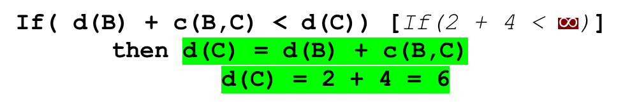

Dijkstra Algorithm
d(C)=6
Relaxation Approach
Initially we take distance between A to B is 2 so d(B) = 2 (cost of B) ad distance between A to c we don’t know till now so we mark it as infinity.
Now if we want to calculate shortest distance between A to C we use Relaxation approach:
Source
d(B)=2
d(C)= $∞$
2
4
A
B
C
U
V
Illustration Graph
If( d(B) + c(B,C) < d(C)) [If(2 + 4 < $∞$)]
then d(C) = d(B) + c(B,C)
d(C) = 2 + 4 = 6

Slide 18



Dijkstra Algorithm
8
9
2
$$∞$$
7
3
4
2
1
Source
1
3
$$∞$$
11
1
6
9
5
6
2
5
2
$$∞$$
5
3
5
Weighted Graph

Slide 19
Dijkstra Algorithm
8
9
2
$$∞$$
3
4
2
1
Source
1
3
$$∞$$
11
1
6
9
2
5
2
$$∞$$
5
3
5
Weighted Graph

Slide 20

Thank you

